Slide 1

[Samsung PRISM] End Review Report
Video Enhancement And Restoration Using Neural Radiance Field
1.College Professor(s): Uma Mudenagudi uma@kletech.ac.in
Ramesh Ashok Tabib ramesh_t@kletech.ac.in
2.Students:
Ajeet Shyanavad 01fe21bcs277@kletech.ac.in
Vineet Gajanan Pai 01fe21bcs273@kletech.ac.in
P Sai Sudheer 01fe21bcs096@kletech.ac.in
Srivatsa Malipatil 01fe21bcs038@kletech.ac.in
3.Department: Computer Science And Engineering
Date: 14 Aug 2024

Slide 2
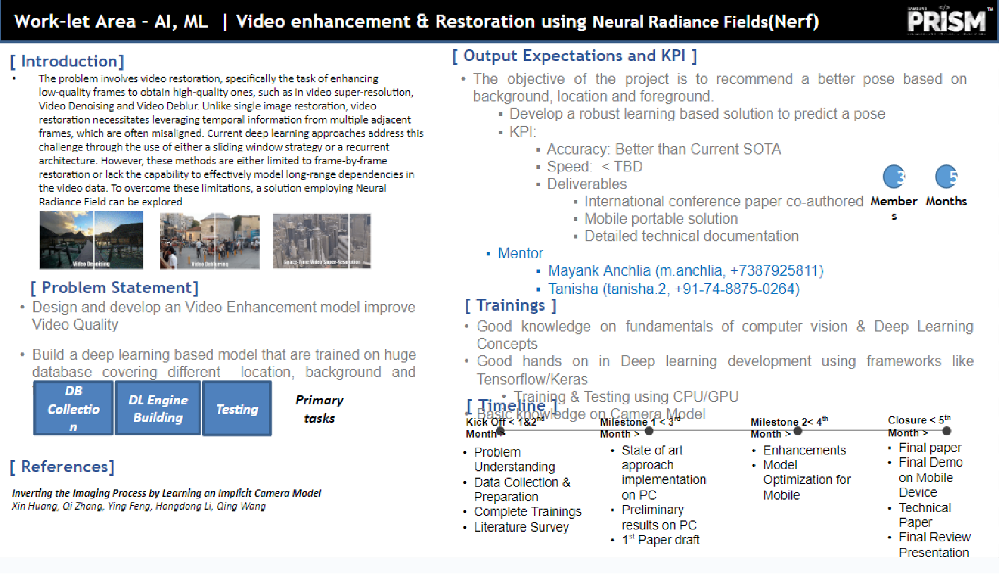




Information Retrieval | SQL to Lucene Query Parser
Problem Statement
Lucene is a High Performance Text Search Engine implemented in Java.
The Query to search Text has to be created using Lucene APIs .
There have been limited attempts to use SQL for forming Lucene Queries. While SQL query is quite famous among developers but lucene query not.
When giving Lucene engine API for text retrieval engine to 3rd party there is learning curve from the developer end to adapt the Lucene query which can cause the integration delay.
The problem statement is to create a module which can take SQL queries as Input and Output an equivalent Lucene Query in real time processing speed so that developer can use the lucene engine without learning new query syntax (lucene in this case)
This will create the abstraction which allow less coupling with any indexing engine.
Expectations
A java library with API (s) to take SQL text query as Input and return a valid equivalent Lucene Query. Mapping Simple and Complex SQL queries to Lucene Query
The SELECT, UPDATE, INSERT and DELETE APIs should be implemented.
Sufficient level of argument complexity should be taken care of. (e.g. Range Query with BETWEEN etc.)
Automatic Unit Test cases running various combinations of SQL Queries and Testing Lucene Query Equivalence.
API Document, Design Document, Implemented Project Code, Unit Test Report.
Training/ Pre-requisites
Trained in Java
Completed Courses:
Data Structures
Databases
Algorithms
Student Learning
Information Retrieval Concepts.
Lucence Text Search Engine Usage.
Design of Interfaces.
Test Driven Development.
[ INSERT YOUR WORK-LET TEMPLATE HERE ]
2
Members
Additional Documentation:
Lucene:
https://lucene.apache.org/
SQL To Lucene Sample :
https://github.com/bbejeck/sql-for-lucene
Srevatsa, Director
srevatsa@samsung.com
Vanraj, Manager
vanraj.vala@samsung.com
Kick Off 15 Sep 18
Understand Lucene
Implement Lucene Queries
Milestone 1 15 Oct 18
Basic Select Statements to Lucene Query working with projection and selection args.
Milestone 2 15 Nov 18
Insert , Update and Delete SQL Query to Lucene Query Working
Test Case Report
Closure 31st Dec 18
Project Report
Test Case Report
Demonstration
Notes:
-

Slide 3
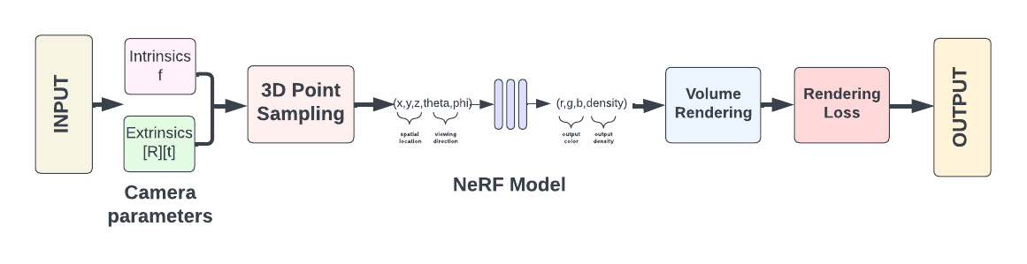
Approach / Solution
Concept Diagram :
( Clear detailed schematic / block diagram / flow chart depicting the proposed concept / solution )

Slide 4
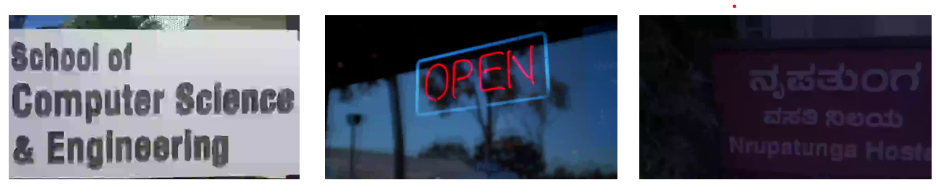
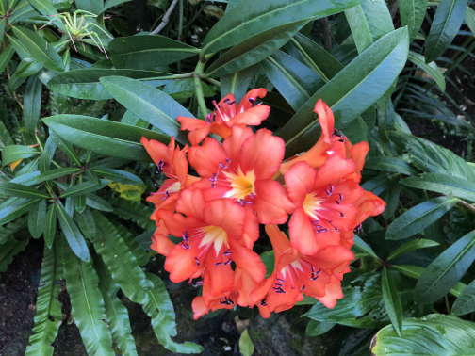
Dataset Description
Dataset Capture / Preparation / Generation :
Standard Datasets: Diverse NeRF datasets, including NeRF-Synthetic, Blender Scenes, and LLFF, provide a range of synthetic and real-world scenes with complex geometries and lighting conditions.
Custom Dataset: Frames from three static videos were extracted and tailored to the academic environment for specific model training and evaluation.
The combination of standard and custom datasets ensures the NeRF model is trained to handle a wide variety of real-world scenes.

Slide 5

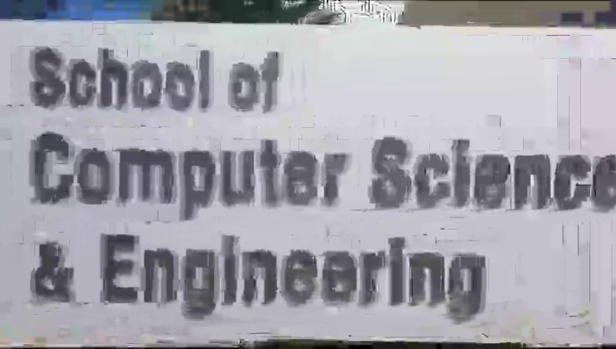
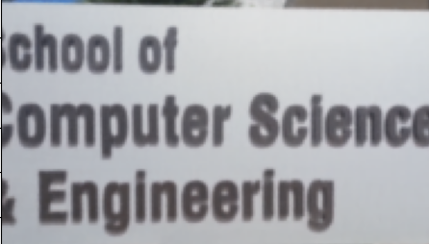

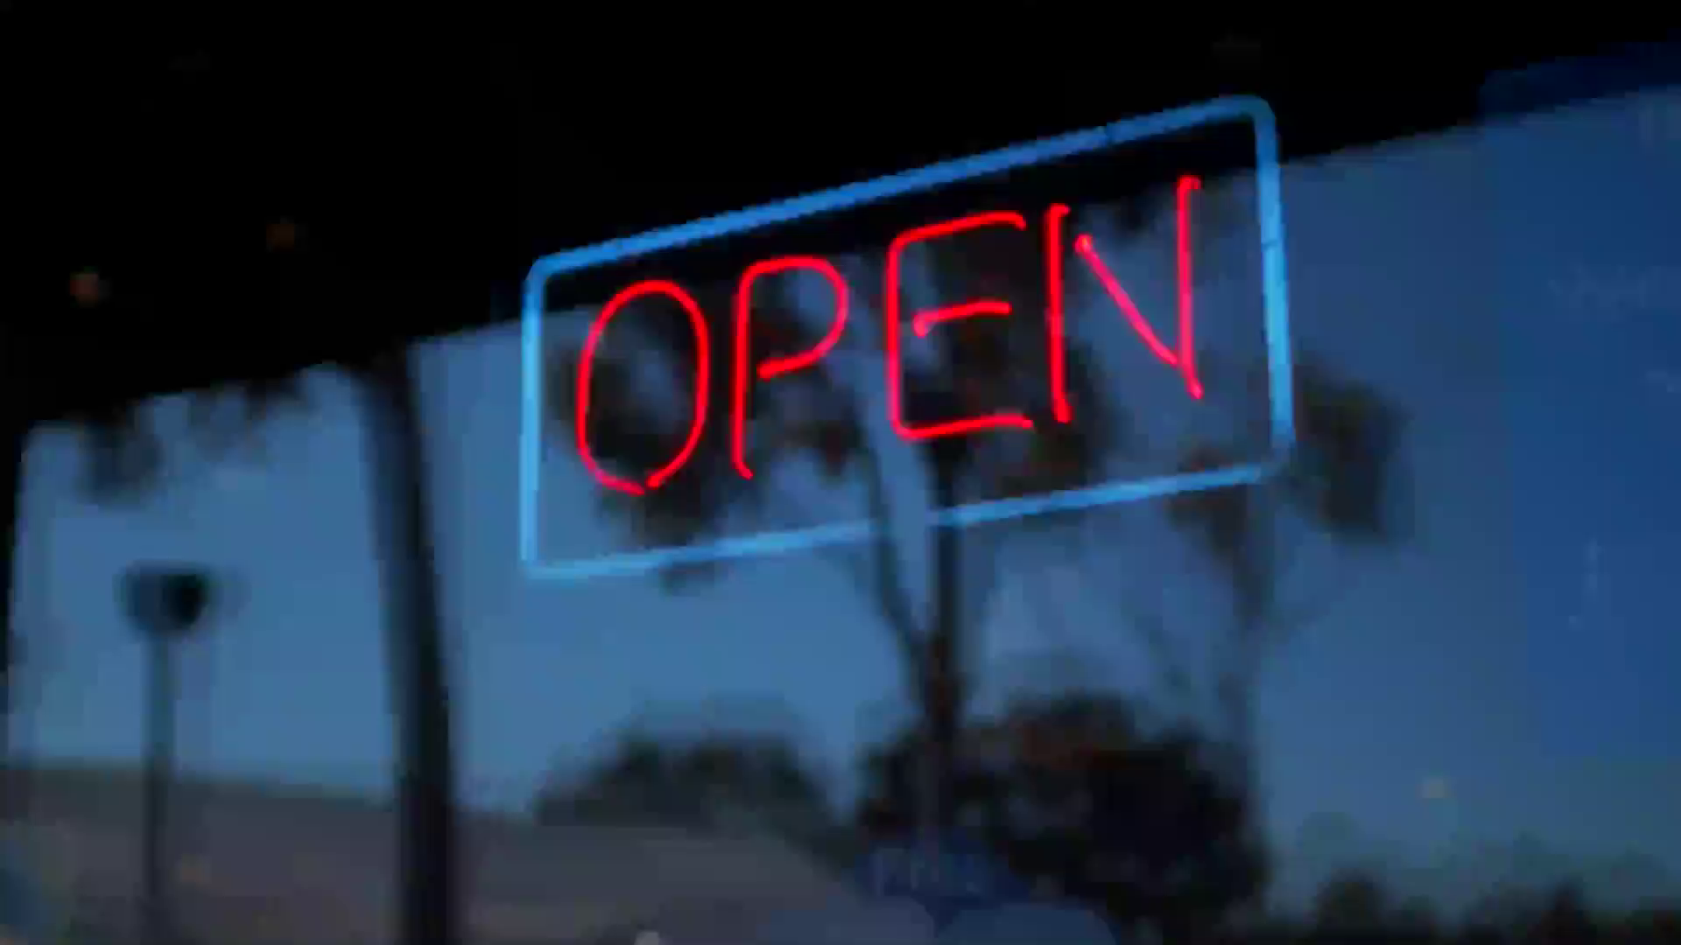

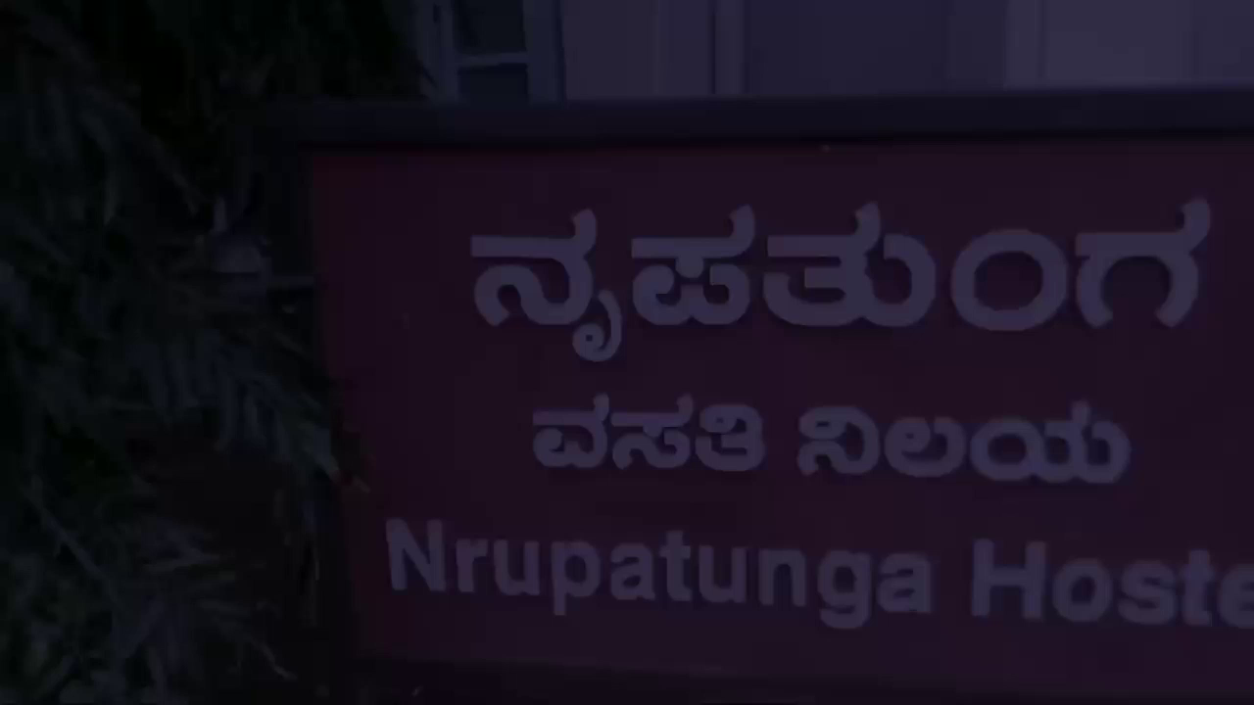
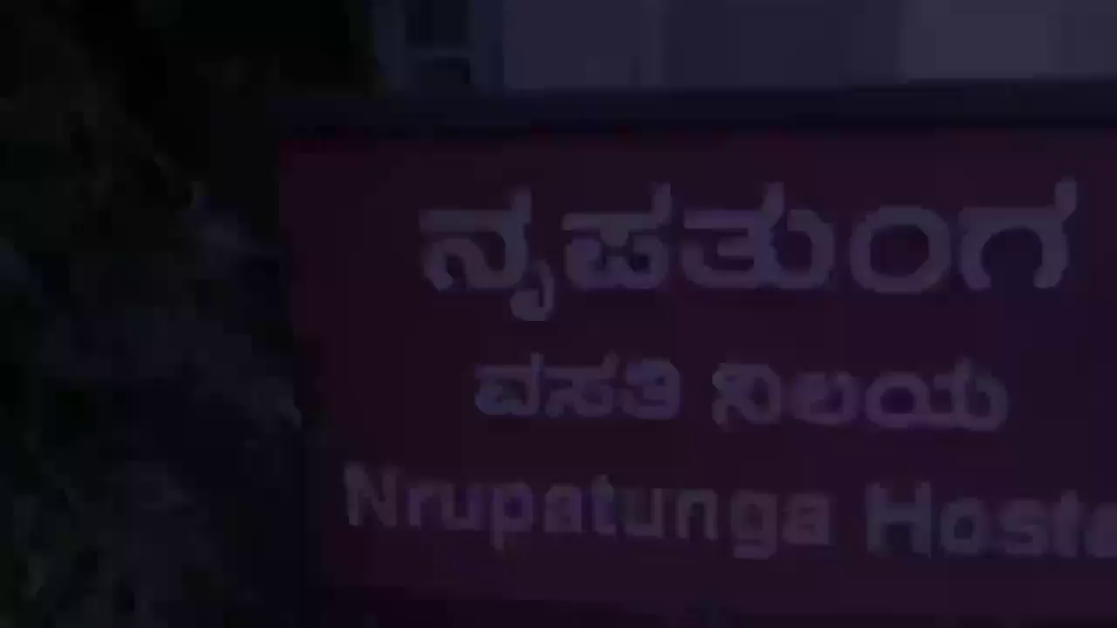
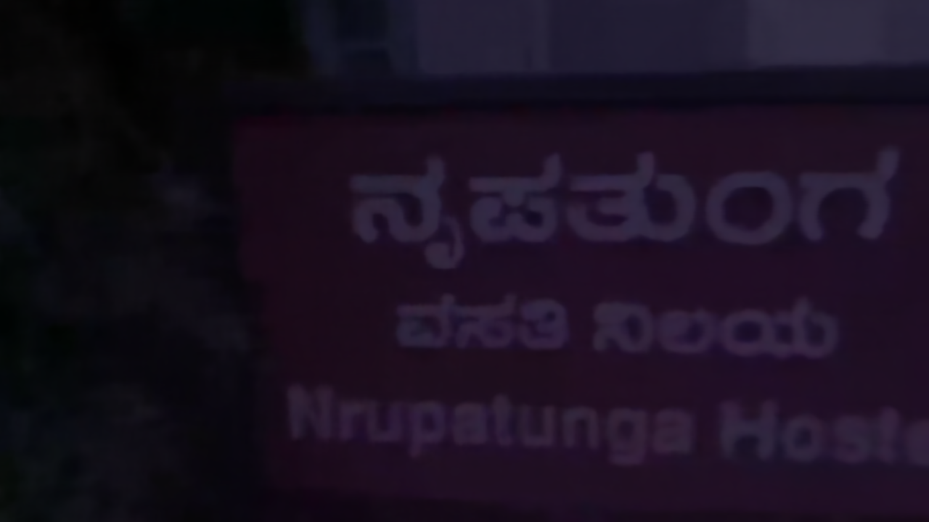
Experimental Results
Results :
GROUND TRUTH
INPUT (Degraded)
OUTPUT
PSNR: 32.66
SSIM: 0.89
PSNR: 32.66
SSIM: 0.91
PSNR: 34.32
SSIM: 0.93

Slide 6


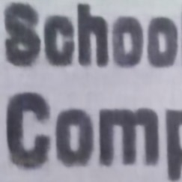
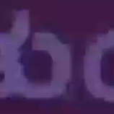


Experimental Results
Zoomed In Results :
Input (Degraded)
Output
Ground truth

Slide 7
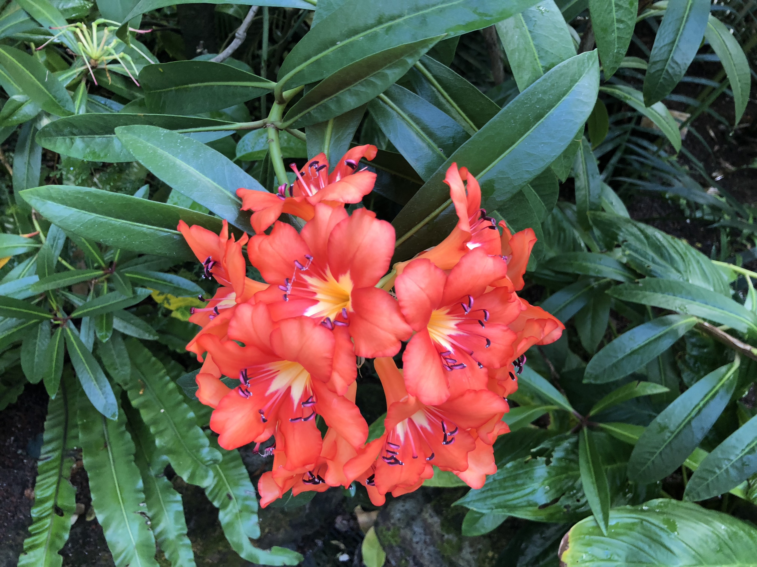
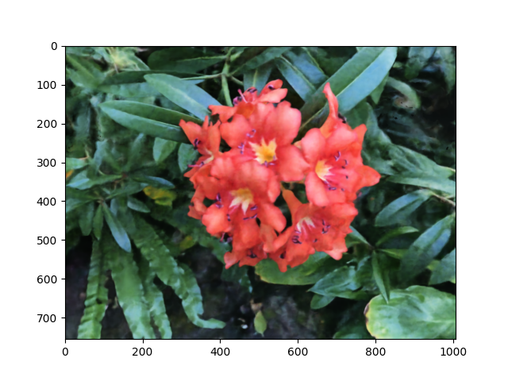
Experimental Results
GROUND TRUTH
INPUT (Degraded)
OUTPUT
PSNR: 25.25
SSIM: 0.78
Comparison of PSNR values for different methods
Model | PSNR
NeRF | 27.54(10000 epochs)
NeRF-Bi | 26.42(10000 epochs)
NeRF-Liif | 27.07(10000 epochs)
NeRF-Swin | 26.34(10000 epochs)
Our model | 25.25(5000 epochs)

Slide 8
Experimental Results
Major Observations / Conclusions & Challenges :
Our model was trained on three custom datasets, which included frames from static videos with varying complexities, as well as standard datasets like NeRF-Synthetic, Blender Scenes, and LLFF. This comprehensive approach exposed the model to a broad spectrum of real-world conditions.
Our model showcased superior performance, achieving PSNR values ranging from 33 to 35 on custom datasets for 2000 epochs and 25.25 for 5000 epochs on standard datasets.
The combination of custom and standard data validated the training technique, enhancing the model's precision in handling complex geometries and lighting, and proving its robustness in producing higher-quality outputs.

Slide 9
Deliverable
Paper :
Abstract—Video enhancement and restoration have emerged as critical tasks in computer vision, especially for applications like video streaming, film remastering, and surveillance. Traditional methods often struggle with artifacts, loss of details, and inadequate handling of temporal consistency. Neural Radiance Fields (NeRF), originally designed for novel view synthesis in 3D scenes, have shown promise in addressing these challenges. This paper explores the application of NeRF in video enhancement and restoration, leveraging its ability to model complex spatial and temporal dependencies. We propose a method that uses NeRF to generate high-quality, temporally consistent frames from low-resolution or degraded video sequences. Experimental results demonstrate significant improvements in video quality, surpassing state-of-the-art methods in both subjective and objective evaluations.
KPIs Delivered :
Accuracy: Better than Current SOTA
International conference paper.

Slide 10
Work-let Closure Details
Code Upload details:
Items | Details
KLOC (Number OF Lines of codes in 000’s) | 1.5
Model and Algorithm details | Tiny NeRF
Is Mid review, end review report uploaded on Git ? | yes
Link for Git | https://github.ecodesamsung.com/SRIB-PRISM/KLE_23VIS50_Video_enhancement_and_Restoration_using_Neural_Radiance_Fields_Nerf
Data details (if applicable):
Items | Data folder 1 | Data folder 2 | Data Folder 3
Name & Type of Data (Audio/Image/Video) | Video1 | Video2 | Video3
Number of data points | 30 | 60 | 61
Source of Data (self collected, Scrapped, available on open source) | self collected | self collected | self collected
Google drive link/ git link to access data | https://drive.google.com/file/d/1bzUk1brCQJerFwCZqoRmZFP2LDb0M5uf/view?usp=sharing | https://drive.google.com/file/d/1bzUk1brCQJerFwCZqoRmZFP2LDb0M5uf/view?usp=sharing | https://drive.google.com/file/d/1bzUk1brCQJerFwCZqoRmZFP2LDb0M5uf/view?usp=sharing

Slide 11
Work-let Name: Video Enhancement And Restoration Using Neural Radiance Field
Worklet Details
Worklet ID: 23VIS50
College Name: KLE Technological University
Professor Comments
Generated an enhanced video as the output of the model.
Explored more scenes with different lighting conditions.
Completed Project within given time
Date: 14/08/24

Slide 12
Thank you

